Slide 1
Maximum Likelihood for estimating Population of Parameters
FINAL PRESENTATION

Slide 2
Abstract
Our aim is to explore the advantages of using MLE to estimate the probability distribution function ( or pmf ) of parameters of a population
This problem arises in numerous domains, including digital communication, where the size of the population under study is usually large while the number of observations per individual is often limited
We have compared MLE with two other estimators using the Wasserstein distance

Slide 3
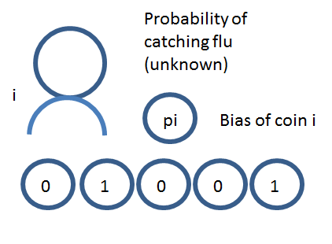
Motivation: Large yet Sparse Data
Example: Flu data
Suppose out of a large random subset of the population, we observe whether a person caught the flu or not for last 5 years
In the regime where t<<N, MLE achieves the minimum possible error bound of O(1/t) when t<clogN
In an exponentially large interval of t beyond c logN, the MLE achieves the error bound of O(1/(√(t logN)) ).
In contrast, regardless of how large N is, the naive "plug-in" estimator for this problem only achieves the suboptimal error of O(1/√t)

Slide 4
Goal: To learn the distribution of the biases over a population
Application domains:
Epidemiology, Social Sciences, psychology, Medicine, Biology
Population size is large, often hundreds of thousands or millions
Number of observations per individual is limited (sparse) prohibiting accurate estimation of parameters of interest

Slide 5
Maximum Likelihood Estimator
Maximum likelihood estimation (MLE) is a method of estimating the parameters of a probability distribution by maximizing the likelihood function, so that under the assumed statistical model the observed data is most probable.
The goal of MLE is to maximize the likelihood function
For estimating P using MLE, P_{MLE} = arg min_{Q Ɛ D}KL( h^{obs} , E_{Q}[h])
●

Slide 6
Empirical estimator
A simple empirical estimate of the probability distribution is obtained from a sample of data by calculating the relative frequency fi=ni/n of occurrence of each event {X=xi}.
In the limit of large sample sizes, these empirical estimates of the distribution provide increasingly accurate unbiased estimates of the population probability distribution.

Slide 7
Moment Matching Estimator
Given a dataset and the distribution we can use this method to estimate the parameters of this distribution.
Assume the problem is to estimate ‘k’ unknown parameters t1,…, tk of a distribution F(w;t1,t2..tk). The steps are:
Estimate the exact moments E(w), E(w^2)... E(w^k) in terms of the parameters.
Calculate ‘k’ sample moments from the dataset
Equate them both to find the values of ‘k’ parameters

Slide 8
Moment Matching Estimator in our setting
In our problem setting, we don’t know the actual distribution.
We can divide the space [0,1] into smaller subspaces and evaluate the weight for each subspace.
We shall be employing linear/quadratic programming techniques to find the weight.
Note: Dividing the subspace will lead to further errors. Hence, the number of divisions are usually high, to reduce this error further.

Slide 9
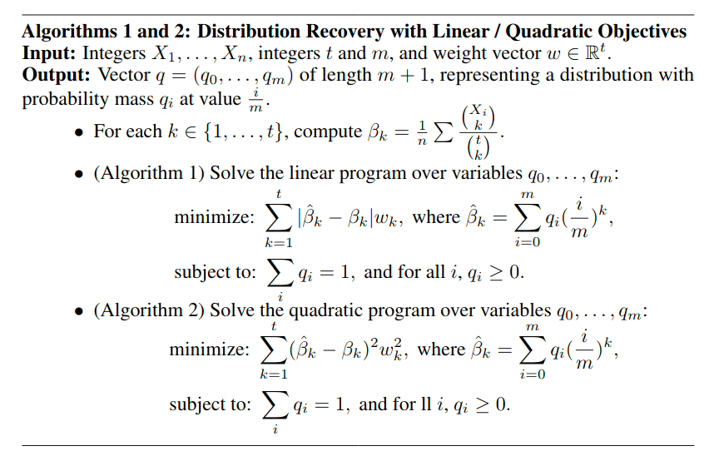

Slide 10

Why does the moment matching estimator fail for large t
Higher order moments can’t be estimated accurately!
Intiutively:
For example: Let’s say we have 2 coins and we toss each coin 100 times.
Estimating 100 moments of just 2 coins isn’t gonna help us estimate the distribution across all coins.
Mathematically:
It would be better to stop with just the first c*log(N) moments while estimating the distribution.

Slide 11
Local Moment Matching for the Rescue
The algorithm for Local Moment Matching consists of three steps:
Binning: Bin the space [0,1] into smaller sub-spaces. Then place each coin into a bin according to the fraction of heads shown by it.
Moment Estimation: The first ‘c*log(N)’ or ‘t’ moments for every bin is estimated using the coins present in that bin.
Distribution Calculation: Do Moment Matching in every bin.
This overcomes the disadvantages of the Moment Matching estimator. In paper, it can achieve the theoretically optimal bound of O(1/t).

Slide 12
Drawbacks of Local Moment Matching
Significant parameter tuning
Requires special treatment for the edge cases.
Using fixed blocks partition of [0, 1]
Matching only the first ‘t’ or ‘log N’ moments

Slide 13
Toy problem
Estimating the load distribution of cell towers in a given area at a particular time
Introduction:
In 5G the number of small and medium-ranged cell towers going to be deployed are much higher.
The number of handovers are going to be higher and thus, the load handled by each cell is going to fluctuate.
Identifying the distribution of loads across cells will give us more information about the network's performance.

Slide 14
Toy problem
Formulating the given problem similar to the coin toss problem
Set a threshold value and see if the load is higher than that or not.
Since frequent handovers happen, the identity of the towers doesn't matter.
This makes the problem similar to that of our coin toss problem.

Slide 15

Wasserstein distance
Measures the similarity between two distributions
Given by :
Used to measure the accuracy of the estimators
Why?

Slide 16
Why do we use the Wasserstein Distance?
Even when two distributions are located in lower dimensional manifolds without overlaps, Wasserstein distance can still provide a meaningful and smooth representation of the distance in-between
That is, if two distributions are disjoint, the EMD is a constant proportional to the distance between the distributions, however other measures such as KL divergence tend to infinity and JS divergence is a constant, hence a non-differentiable function at K_JS=0
Only Wasserstein metric provides a smooth measure, which is helpful for a stable learning process using gradient descents

Slide 17
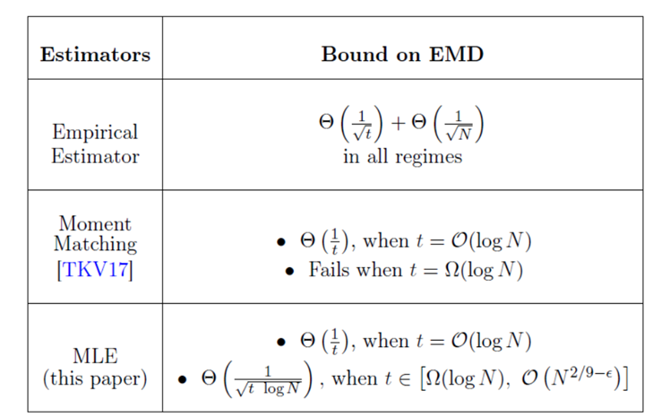
RESULTS

Slide 18
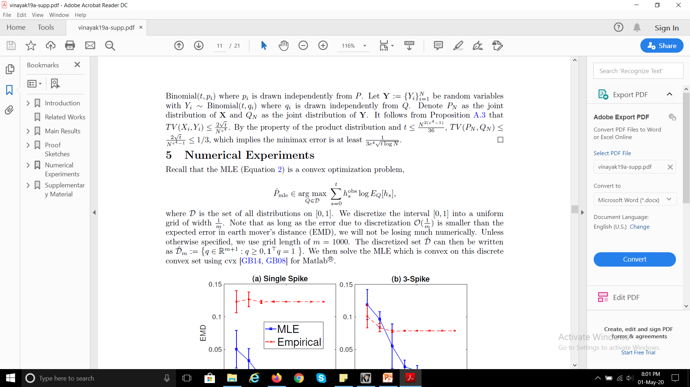
Implementation
We have to solve the following convex optimization problem:
where D is the set of all distributions on [0,1]. We discretize the interval [0,1] into a uniform grid of width m. As long as the error due to discretization O(1/m) is smaller than the expected error in earth mover’s distance (EMD), we will not be losing much numerically. Unless otherwise specified, we use grid length of m = 1000. We then solve the MLE which is convex on this discrete convex set using cvx for Matlab

Slide 19
Simulation Results
Synthetic data :
For different orders of t w.r.t N, we carried out simulations, assuming some distribution for the biases( Gaussian, Cauchy, single-spike, triple-spikes and uniform ):
Note : We have shown simulation results using truncated Gaussian and Cauchy as the synthetic data, however, the other distributions follow the same trends.

Slide 20
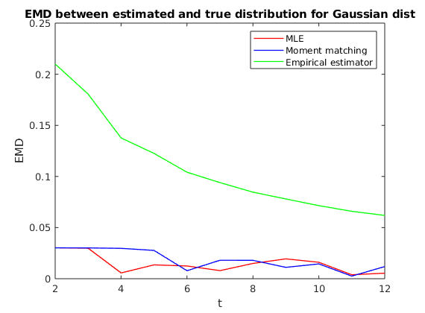
t is of the order log(N) ~ small t

Slide 21
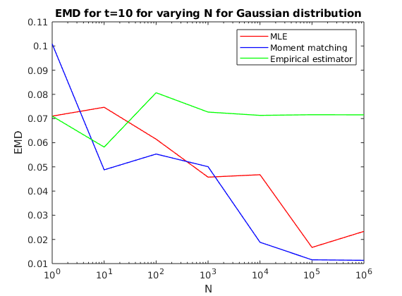
For varying values of N, with t constant

Slide 22
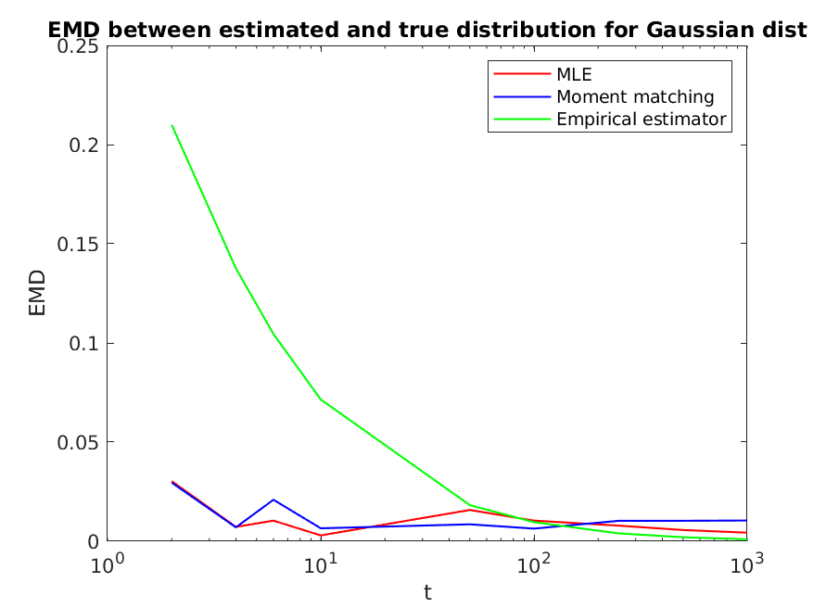
t is greater than the order log(N) ~ large t

Slide 23
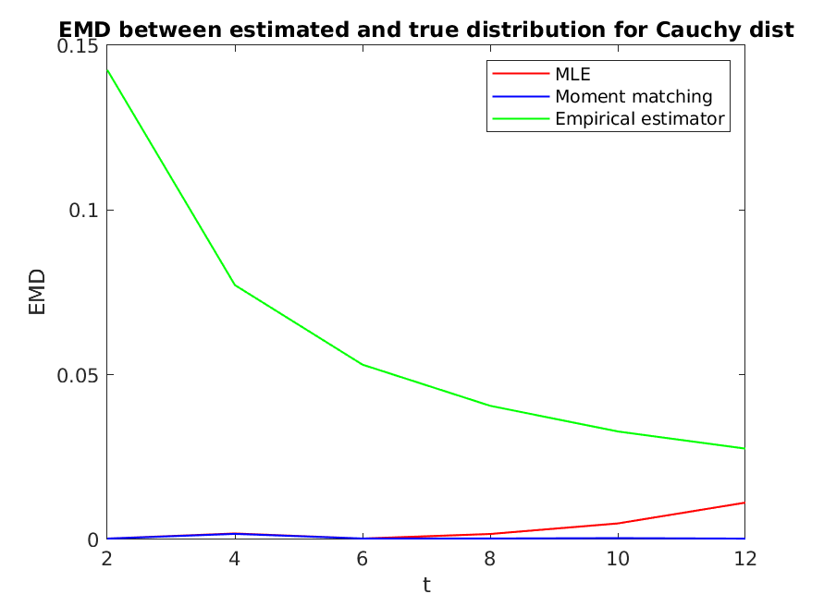
t is of the order log(N) ~ small t

Slide 24
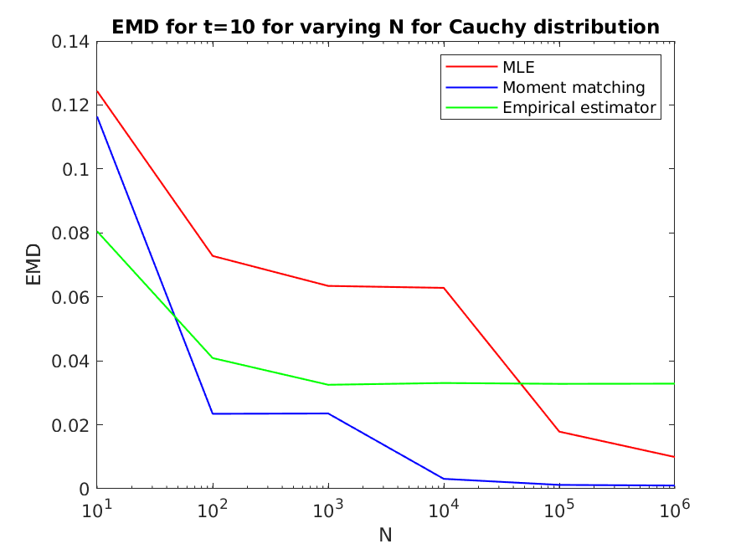
For varying values of N, with t constant

Slide 25
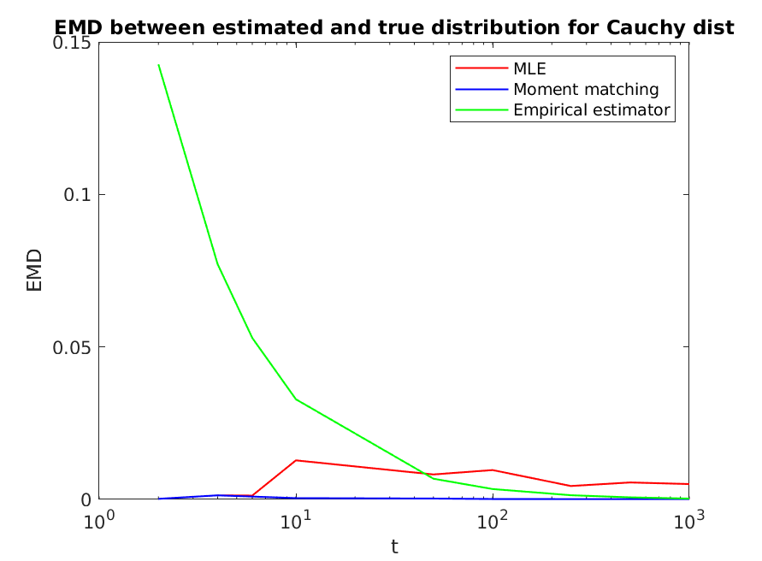
t is greater than the order log(N) ~ large t

Slide 26
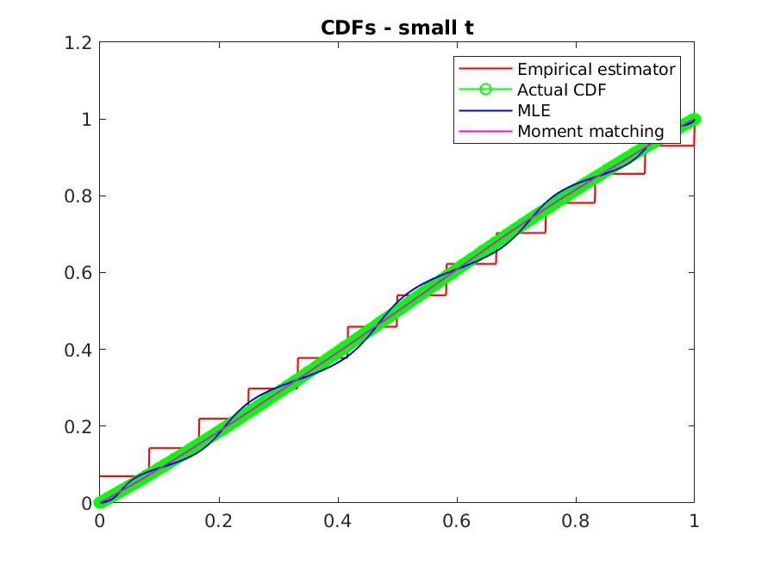
Comparing CDFs

Slide 27
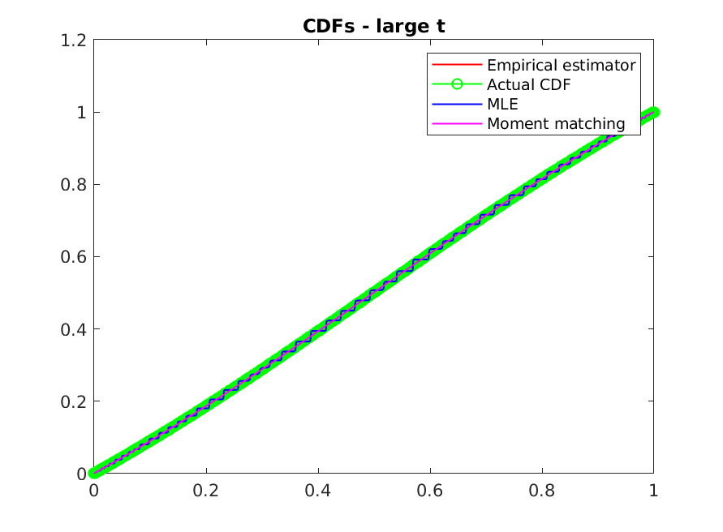
Comparing CDFs

Slide 28
References
Code : GitHub - https://github.com/ramyakv/mle-for-population-params-binomial/blob/master/learnpopulationparamsBinomialMLE.m
https://en.wikipedia.org/wiki/Method_of_moments_(statistics)
https://online.stat.psu.edu/stat414/node/193/
https://arxiv.org/pdf/1709.02707.pdf

